Slide 1
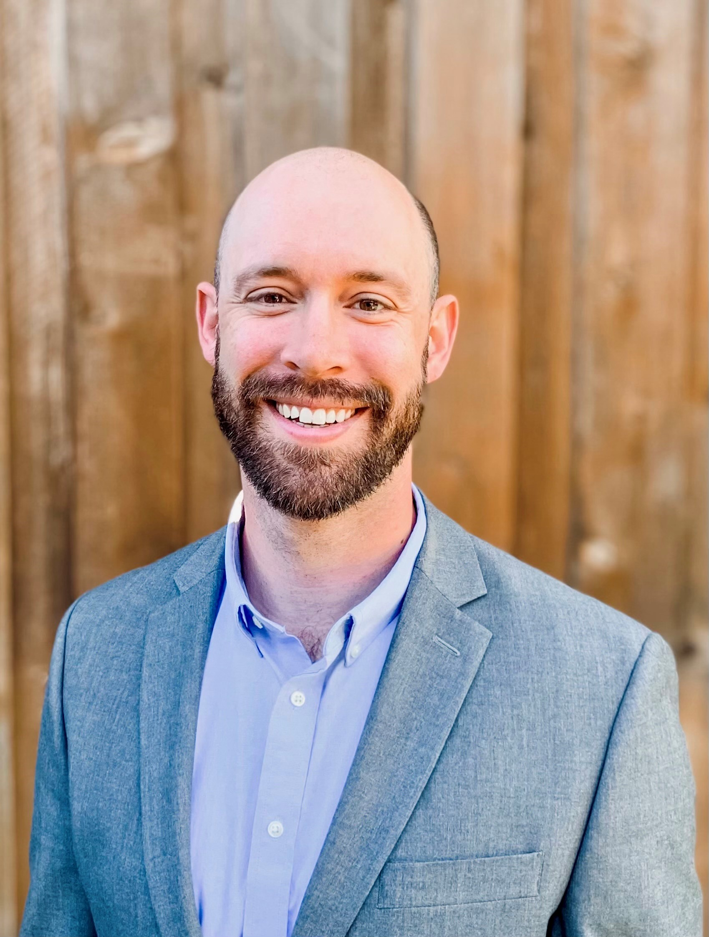
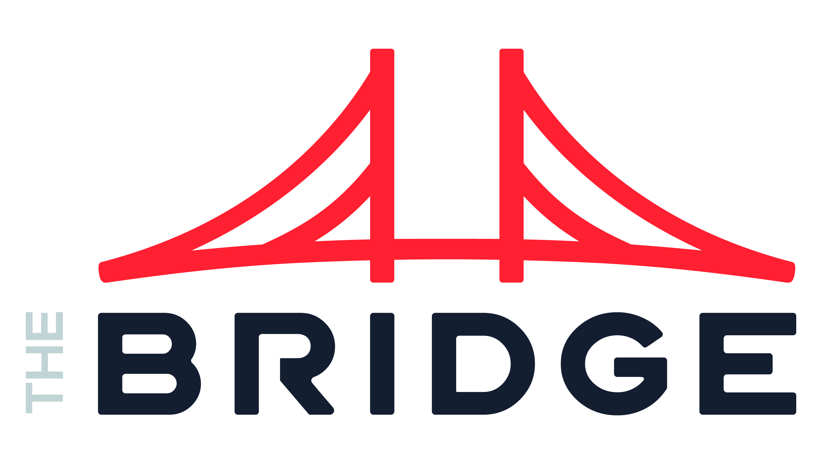
Eric Hilton Data & AI
INDUSTRIES
Industry Experience
Consumer and Industrial Products | Healthcare | High-Tech & Software | Private Equity | Real Estate | Retail | Financial Services | Restaurant
EXPERIENCE
Forecast and AR Visal Insights | Healthcare
Problem: Client needed to analyze a massive dataset (5+ Tb) of claims data to understand its forecast and inventory. Client needed direction in how to visualize and represent data in an impactful way
Value: Eric and team guided Client through visual design and KPI building sessions to limit a report sprawl of 40 down to 8, and created impactful set of insights to Inventory, AR, and Status plus delivered a second set of reports focused on improving cashflow via data analysis
Tools: Databricks, Azure Data Factory, Power BI
Role: Functioned as a team and technical lead facilitating sessions to identify and validate use cases, gather project success requirements, data engineering, data modeling, data analysis, data visualization, project progress reporting and accountability
Improved Data Reliability | Consumer and Industrial Products
Problem: Client's data users did trust or understand the data delivered by its data team. They instead used inaccurate and manual processes to make cashflow-impacting business decisions
Value: A data cataloging tool was installed to serve as a data lineage tracker and business glossary. Users could track their data from source to target and understand metrics, allowing them to better leverage delivered and build their own
Tools: Oracle, Informatica, Alation
Role: Functioned as data lead and architect facilitating requirements gathering sessions, built and reviewed business definitions, and provided technical implementation support
BACKGROUND
Functional Skills
Data Leadership | Organizational Design | Generative AI Strategy | ML | MLOps | Data Science | Data Architecture | Data Engineering | Data Analysis and Visualization
Qualifications:
Consulting leader focused Data & AI strategy and implementation. Eric’s strategy experience involves advising over 200 companies up and down the market with unique ownership structures including private equity owned, owner operators, and publicly held. Eric’s implementation experience is similarly vast delivering quantifiable value in the form of enterprise data capabilities aligned with business outcomes
BIO & CONTACT INFO
Email
Eric.Hilton@thebridge.com
Mobile
(972) 757-3348
Location
DFW, Texas
Eric has over 15 years consulting in Data and AI serving companies in the fortune 10 and startups alike. He’s passionate about data, agile delivery, efficiency, and delivering measurable value. In his free time, he enjoys spending time with his family, serving his community, coaching youth sports, and riding his Peloton

